Slide 1


Managed DevOps Pools the answer to my build agent provisioning problem?
Richard Fennell
Chief Technology Officer (CTO)
MVP (Developer Technologies)

Slide 2








Richard Fennell
Chief Technology Officer (CTO)
MVP (Developer Technologies)
@RichardFennell
richardfennell.bsky.social

Slide 3



Azure DevOps Pipelines
Azure DevOps Organisation
Microsoft Managed Azure Hosted
Team Project
Agent Pool
Team Project
Agent Pool
Self hosted ‘Agents’
Anywhere of your choice
Team Project
Notes:
Azure Pipelines Agents - Azure Pipelines | Microsoft Learn
Microsoft-hosted agents - Agents hosted and managed by Microsoft Azure DevOps Services
Self-hosted agents - Agents that you configure and manage, hosted on your VMs

Slide 4
Self hosted
So how do I manage my base images?
Pros
Under your control
Meet any special requirements
Useful for debugging
Can be on your network
Cons
Managing updates
Configuration drift
Cost of hosting
Notes:
You can of course use any text editor, you are editing text files in a Git repo

Slide 5
Managing Self Hosted Agent Images

Slide 6
Options
Manual build of VM/PC
Gallery Images from cloud providers
Provisioning tools
Microsoft Deployment Toolkit (MDT)
DISM (Deployment Imaging Service and Management Tool)
Desired State Configuration (Windows)
HashiCorp Packer

Slide 7
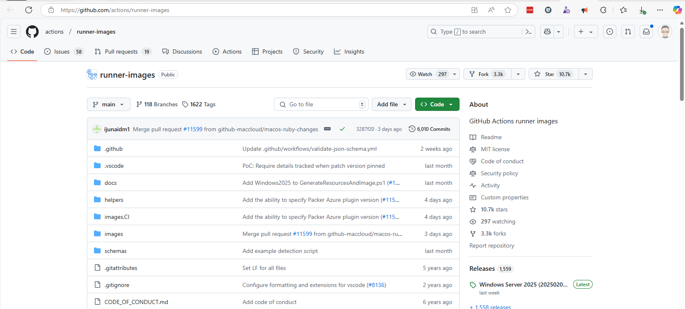
GitHub Actions Runner Images
https://github.com/actions/runner-images
Notes:
actions/runner-images: GitHub Actions runner images

Slide 8
Demo: A look at Packer
Notes:
https://dev.azure.com/blackmarble-source/AzurePipeline-Images
We have a branch that contains a folder with all our changes – why do we do this, easy for merges?
Show we run packer that run with a config file and a /images/windows/templates

Slide 9
So what do you do with the Image?
Could use with Azure Gallery (or AWS/Google Cloud)
Pull down to use as on Hyper-V (or VirtualBox/VMWare)
Can then use it ‘by hand’
Or we use tooling to manage the VM creation process ‘Lability’
Notes:
Interestingly the VHD is on an Azure Gallery, so could use it from there

Slide 10
Demo: A look at Lability
Notes:
https://github.com/VirtualEngine/Lability wrappers DSC
https://dev.azure.com/blackmarble-source/BM/_git/VmcDefinitions

Slide 11
Azure DevOps – Other Options

Slide 12
Azure DevOps
MS Hosted Images
Std Azure Images
Custom Images
Azure DevOps Organisation
Managed DevOps Pools
Std Azure Images
Custom Images
Virtual Machines Scalesets
Team Project
Agent Pool
Team Project
Private Azure VNet
Team Project
Notes:
We will come back to environment deployment agents later in the course
VMSS older technology – avoid today in favour of MDP
MDPs are new and in review
The replace Virtual Machine Scale sets
Can used same images as hosted agents
Can connect to vNETs
Scale dynamically
Managed DevOps Pools documentation - Azure DevOps | Microsoft Learn
On the roadmap for GitHub

Slide 13
Demo: A look at MDP

Slide 14
Summary
Using the vendor hosted agents/runners is much easier
If you have specialist needs, or more performance look at Managed DevOps Pools
If you have to use self hosted
Build you images using IAC principles
Make sure you patch your images for OS and SDK updates
Make sure it is easy to replace an agent to avoid the ‘we can only build it on that machine’ nightmare

Slide 15

Notes:
Walk through each of the menu options for Azure DevOps pipelines

Slide 16
Richard Fennell
Chief Technology Officer (CTO)
MVP (Developer Technologies)
@RichardFennell
richardfennell.bsky.social

